Slide 1
Portfolio Optimization
NYC Data Science Academy
By: Nickolas Abrarpour

Slide 2
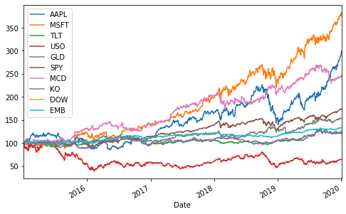
Processing the Data
The historical prices data was scraped from Yahoo Finance and merged into a single pandas DataFrame.
Normalized data for individual asset returns

Slide 3
Modern Portfolio Theory
Quantitative framework founded by Harry Markowitz in the 1950s
Replaced the investment world’s reliance on judgement with statistical and mathematical models
Statistical models applied to portfolio theory rest on the assumption returns of securities are normally distributed

Slide 4
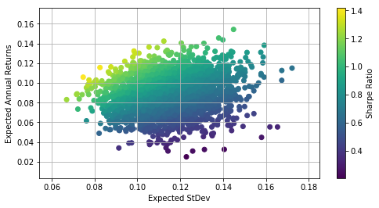
Monte Carlo Simulation
Generate vectors of random portfolio weights on a larger scale.
Record return and variance for all portfolio simulations
Analyze the simulations that generated an optimal risk-reward relationship

Slide 5
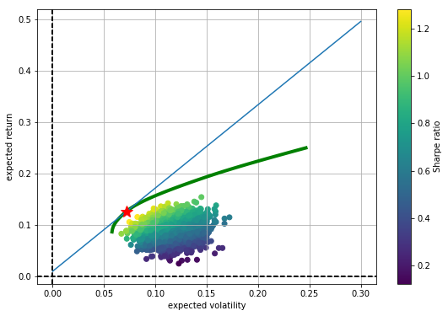
Efficient Frontier
The derivation of all optimal portfolios - i,e, all portfolios with minimum volatility for a given target return level (or all portfolios with maximum return for a given level of risk level) - is similar to the previous optimization
The only difference is that we have to iterate over multiple starting conditions. The approach we take is that we fix a target return level and derive for each such level those portfolio weights that lead to the minimum volatility value.
For the optimization, this leads to two conditions: 1.) target return level 2.) sum of portfolio weights.

Slide 6
Data Takeaways

Slide 7
Further Exploration
Construct an algorithmic position sizing tool based on volatility and correlation of each individual component from a portfolio perspective

